Slide 1
Team History
GCSE History
Masters of recall
America 1920-73 Opportunity and inequality
Name: ……………………………………………………………..
Teacher: ………………………………………………………….
“Enabling all individuals to unlock their unique potential”

Slide 2
Every activity that you do in your silent start will be completed in this booklet.
All of the activities are designed to recap knowledge and link knowledge together. It is important that you constantly review your learning and use your knowledge organisers at home.
To be successful in GCSE History, you must know your content inside out. This booklet is the first step on that journey.
 | Topic | Content to focus on
American people and the ‘Boom’
Lessons 1 - | The ‘Boom’
 | Social and cultural developments
 | Divided society
Bust – Americans’ experiences of the Depression and New Deal
Lessons - | American society during the depression
 | The effectiveness of the New Deal on different groups in society
 | The impact of the Second World War
Post-war America
Lessons - | Post-war American society and economy
 | Racial tension and development in the Civil Rights campaigns
 | America and the ‘Greta Society'

Slide 3
Why was there an economic boom in the 1920s?
Americans were worried at the cost of keeping the peace
Americans did not want to lose any more men
The Republicans believed in Isolationism- keeping out of Europe’s problems
Woodrow Wilson and the Democrats lost the 1919 elections.
The league was linked to the T of V which many Americans thought was unfair
America did not want disruption to business
Many Americans were anti-British and anti-French
Some Americans were anti-empire and did not want to protect colonies
Many Americans had escaped problems in Europe and did not want to get involved again
American people and the ‘Boom’
Political
Social
Economic
Connect
How happy was Wilson with the settlement at the Treaty of Versailles
Green for growth

Slide 4
Why was Henry Ford so important?
Mass production means that goods can be made a lot cheaper
American people and the ‘Boom’
Hire purchase helps people buy goods
People spend their wages on more goods
More people can afford to buy goods
More people employed to make these goods
Advertising persuades people to buy even more goods
Connect
Did a Republican Government make a ‘boom’ more likely?
Green for growth

Slide 5
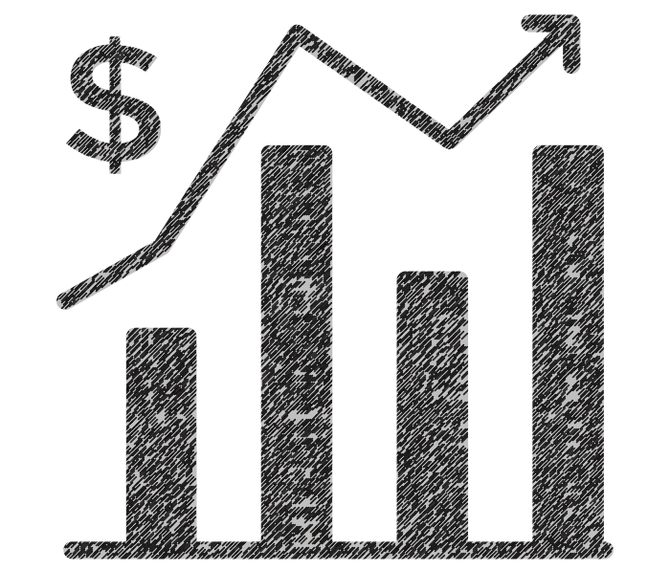
The Stock Market Boom
Define Mass production
Define Speculation
Define prosperity
Define Hire Purchase
Knowledge questions
Who was the Republican President March 4, 1921 - August 2, 1923. who focused on getting America back to normal after war.
How much did the Model T Ford cost in 1925?
Name one group who were excluded form the ‘boom’
How much was Babe Ruth paid a year?
Dates
When was Prohibition introduced?
When was the Emergency Quota’s Act introduced?
 |  | Total /10
American people and the ‘Boom’
Corrections – target things to learn
1)
2)
3)
Green for growth

Slide 6
The Roaring Twenties
American people and the ‘Boom’
Connect
Explain how a growing business can help other industries grow. Use Ford as your example
Green for growth

Slide 7
How was life changing for American women in the 1920s?
Define Democratic Party
Define Republican Party
Define Laissez-faire
Define Hire Purchase
Knowledge questions
Who used the assembly line to create cars?
Which Famous actor in silent movies was born in England and earned $1500 a week in the 1920s?
How many women were working by 1929?
Give one example of a 1920s ‘crazy craze’
Dates
When was the end of the First World War?
When did the Ku Klux Klan reach peak membership?
 |  | Total /10
American people and the ‘Boom’
Corrections – target things to learn
1)
2)
3)
Green for growth

Slide 8
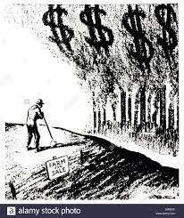
How was life changing for American women in the 1920s?
Define American Dream
Define Consumerism
Define Roaring Twenties
Define Congress
Knowledge questions
How did flappers behave?
What class did the ‘flapper’ tend to come from?
Which city did Al Capone ‘run’?
Which laws helped to increase racial tension?
Dates
When was the National Origins Act passed?
When was the Sacco and Vanzetti case?
 |  | Total /10
American people and the ‘Boom’
Corrections – target things to learn
1)
2)
3)
Green for growth

Slide 9
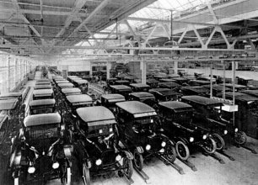
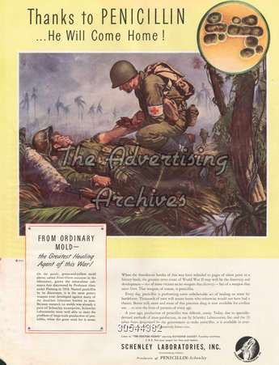
What was Prohibition and why did it fail?
American people and the ‘Boom’
Describe the historical event in this image
……………………………………………………………………………………………………………………………………………………………………………………………………………………………………………………………………………………………………………………………………………………………………………………………………………………………………………………………………………………………………………………………………………………………………………………………………………………………………………………………………………………………………………………………………………………………………………………………………………………………………………………………………………………………………………………………………………………………………………………………………………………………………………………………………………………………………………………………………………………………………………………………………………………………………………………………………………………………………………………………………………………………………………………………………………………………………………………………………………………………………………………………………………………………………………………………………………………………………………………………………………………………………………………………………………….………..
Describe the historical event in this image
……………………………………………………………………………………………………………………………………………………………………………………………………………………………………………………………………………………………………………………………………………………………………………………………………………………………………………………………………………………………………………………………………………………………………………………………………………………………………………………………………………………………………………………………………………………………………………………………………………………………………………………………………………………………………………………………………………………………………………………………………………………………………………………………………………………………………………………………………………………………………………………………………………………………………………………………………………………………………………………………………………………………………………………………………………………………………………………………………………………………………………………………………………………………………………………………………………………………………………………………………………………………………………………………………………….………..

Slide 10
Al Capone and Prohibition
Find it and fix!
In each box there is at least one error. Find and highlight the error and around the side, correct the error using your correct own knowledge.
American people and the ‘Boom’
The Democrat government had a policy of Laissez-faire meaning business could make more money. | The first mass produced car was the ‘Model Z’ Ford. It made cars affordable to the ordinary person in America. | Charlie Chaplin was a famous actor in ‘talkies’.
Alvin ‘Shipwreck’ Kelly set the record for flagpole sitting when he remained on top of a flagpole for 50 days. | When an investor gets money back from a business this is called a share. | Hire purchase made it more difficult to buy products like cars.
42% of families in America has an income of less than $1500 a year, they were living below the poverty line. | Reservations were set up for Native Americans to live on. This preserved their lifestyle and gave them good land to farm. | Working class women were the ones you would associate with being a ‘flapper’
Connect
So far, do the 1920s deserve the tag ‘Roaring Twenties’?
Green for growth

Slide 11
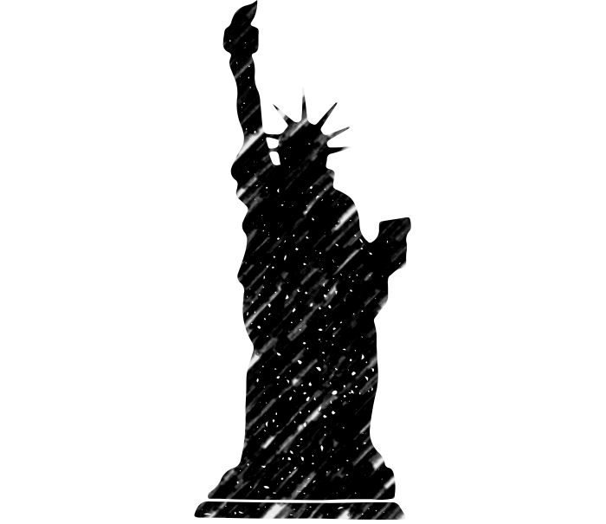
America and immigration
Define Immigration
Define Credit
Define Ku Klux Klan
Define Prohibition
Knowledge questions
When was Calvin Coolidge President?
Which rival gang did Capone target in the St. Valentine’s Day Massacre?
What did Herbert Hoover believe in?
How many women were working by 1929?
Dates
When did Herbert Hoover become President?
When was the St. Valentines Day Massacre?
 |  | Total /10
American people and the ‘Boom’
Connect
Explain the different members of society that made up America before the 1920s.
Green for growth

Slide 12
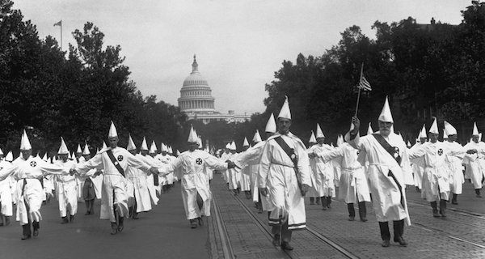
What was life like for African Americans in the 1920s?
Interpretation E: Elias Garza, from Mexico, describes hi own immigrant experience in the USA in the 1920s; from a collection of autobiographical Mexican immigrant life stories (published 1931)
Here in the United States they drive one crazy from working so much. They squeeze one here until one is left useless. I heard that there were some good jobs here in the United States and that good money could be made. We worked on the tracks, taking up and laying down the rails, and doing all kinds of hard work. They only paid us $1.50 and exploited us without mercy, for they sold us everything very high. I don’t even like to deal with those bolillos (Americans) for the truth is that they don’t like the Mexicans.
American people and the ‘Boom’
Interpretation F: Tony, a Greek-born restaurant owner, interviewed in 1939 for the Federal Writers’ Project, a US government scheme
When I came here I knew nothing, couldn’t even speak English. I had a terrible job as a cleaners but one day a customer asked me if I wanted to help him in his restaurant. I worked my way up, learning all the time, married an American woman and now I own my own restaurant. I’m a success – in fact, I believe any hard worker with common sense can make it here.
How are they different? (Inside the box) | Why are they different? (Outside the box)
Connect
Which is the most convincing?
Green for growth

Slide 13
The Red Scare
Circle/highlight the correct group/event the fact belongs to
What is the name of the law that came before the National Origins Act?
What did Capone’s men dress as during the St. Valentine’s Day Massacre?
 | Total: /8
Prohibition
Women
Roaring 20s
Immigration
National Origins Act 1924
January 1920
Workers were earning, on average, nearly twice as much as those in other countries
1929, 10.5 million working. 25% more than in 1920
Alvin ‘Shipwreck’ Kelly
Izzy Einstein and Moe Smith
American people and the ‘Boom’
Connect
Did the immigration laws make Americans more or less tolerant of people arriving into America? Explain your answer.
Green for growth

Slide 14
Why did the Wall Street Crash happen?
Multiple choice knowledge
Who was the Republican President March 4, 1921 - August 2, 1923. who focused on getting America back to normal after war.
Calvin Coolidge | Woodrow Wilson |  | Warren Harding
Famous actor in silent movies. Born in England. Earning $1500 a week. A fortune in the 1920s.
Charlie Chaplin | Henry Ford |  | Babe Ruth
National Origins Act introduced
1921 | 1924 |  | 1927
What is being described ‘A social and economic order and ideology that encourages the acquisition of goods and services in ever-increasing amounts’
Hire Purchase | Cycle of Prosperity |  | Consumerism
What is being described ‘A political party who liked to keep hold of traditions and stay out of people’s lives. A kind of Businessman's party’
Republican Party |  | Democrat Party
These were hugely popular. 100 million people went a week by 1929
Sports games | Car show rooms |  | Cinemas
These were a new sort of woman. They wore more revealing clothes, rode motorbikes, smoked and went out without a chaperone.
Tappers | Flappers |  | Nappers
When was prohibition introduced?
January 1920 | February 1920 |  | March 1920
Which of these is the name for the full American national government?
Senate | House of Representatives |  | Congress
Which and land boss had his men murder a rival gang in the St. Valentine’s Day Massacre
Bugs Moran | Bugsy Malone |  | Al Capone
How much did the Model T cost in 1925?
$315 | $285 |  | $295
Bust – Americans’ experiences of the Depression and New Deal

Slide 15
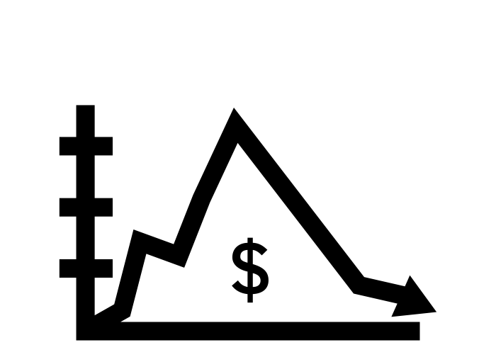
The Great Depression – How did it affect lives?
Define Dustbowl
Define Breadlines
Define Overproduction
Define Rugged Individualism
Knowledge questions
Which president believed in Rugged Individualism?
How much were taxes cut by in 1930?
How many were going to the cinema a week?
How many had lost their jobs by 1932?
Dates
When was the Hawley-Smoot tariff introduced?
When was the Emergency Relief Act introduced?
 |  | Total /10
Bust – Americans’ experiences of the Depression and New Deal
Connect
Explain why so many people who had worked in the ‘Roaring 20s’ were now unemployed.
Corrections – target things to learn
1)
2)
3)

Slide 16
Why did Roosevelt win the 1932 election?
Define Economic Depression
Define Hooverville
Define Bonus Army
Define Supreme Court
Knowledge questions
How much did Roosevelt cut the pay of government workers by? How much did this save?
How much money did the Emergency Relief Act make available?
How much did factory production drop by between 1929 – 1932?
Which book did this period inspire Steinbeck to write?
Dates
When was Roosevelt elected? Month and year
In what year did the ‘New Deal’ start?
 |  | Total /10
Bust – Americans’ experiences of the Depression and New Deal
Connect
Using the words Rugged Individualism and Laissez-faire, explain why you think President Hoover might have lost the election.
Corrections – target things to learn
1)
2)
3)

Slide 17
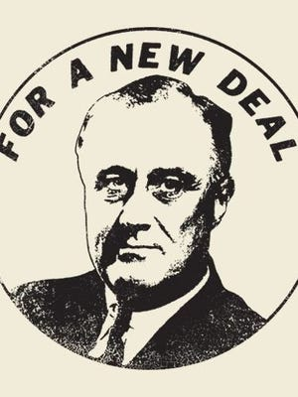
What was Roosevelt's ‘New Deal?
Define Flapper
Define ‘Brains Trust’
Define Alphabet Agencies
Define Cycle of Prosperity
Knowledge questions
What was the Hawley-Smoot Tariff?
What issues did Prohibition cause in America? Give two issues.
Who was Senator Huey Long?
How many people stopped paying their mortgages during the Depression?
Dates
In what year did the Second World War Start?
In what year did the USA enter the Second World War?
 |  | Total /10
Bust – Americans’ experiences of the Depression and New Deal
Connect
Why do you think Roosevelt removed the prohibition laws? Use Organised crime and corruption in your answer.
Corrections – target things to learn
1)
2)
3)

Slide 18
Opposition to the New Deal
Interpretation A: From an interview with a businessman who supported the Republican Party in New York just after Hoover’s defeat in 1932. Published in ‘Hard Times: An Oral History of the Great Depression’.
Hoover happened to be in a bad spot. The Depression came on, and there he was. If Jesus Christ had been there, he’d have had the same problem. It’s too bad for poor old Hoover that he happened to be there. This was a worldwide Depression. It wasn’t Hoover’s fault. In 1932, a Chinaman or a monkey could have been elected against him, no question about it.
Interpretation B: The historian Cabell Phillips, writing in From the Crash to the Blitz, 1969. An honest look at the American scene during the thirties with emphasis on the political aspects of the era.
Roosevelt showed himself to the voters in every part of the country. He showed that his physical problems were no barrier to him. The country gained a picture of him as a man with the poise and self-assurance of an experienced politician. The thousands who saw him found his optimism infectious and exhilarating. As the earnest, plodding defender of the existing government, Hoover was no match for Roosevelt’s fast-paced attack.
Bust – Americans’ experiences of the Depression and New Deal
How are they different? (Inside the box) | Why are they different? (Outside the box)
Connect
Which is the most convincing?
Green for growth

Slide 19
How effective was the New Deal?
Ultimate recall challenge
Who discovered Penicillin in 1928?
Howard Florey | Ernst Chain | Alexander Fleming
Who discovered Germ Theory in 1861?
Robert Koch | Louis Pasteur | Paul Ehrlich
When was the first Public Health Act introduced?
1847 | 1848 | 1849
Which of these was not suggested as a cause of the Black Death in the 1300s?
Rats | Miasma | Misaligned planets
Which of these statistics does not appear in the Treaty of Versailles?
£6,600 million | 100,000 men | 3 submarines
Which treaty dealt with Austria at the end of the First World War?
Sevres | Lausanne | St. Germain
Which of these is not a League of Nations Commission?
The Poverty Commission | Central Opium Board | World Health Organisation
Which of these actions of Hitler did not break the Treaty of Versailles?
Anglo-German Naval Agreement | The Saar plebiscite | Anschluss
Which of these Alphabet Agencies was made illegal by the Supreme Court?
HOLC | NRA | AAA
What was the total number of immigrants allowed into America by the National Origins Act? (1924)
150,000 | 275,000 | 350,000
How many shares were sold on Black Thursday, 24th Oct 1929?
13 million | 14 million | 15 million
Bust – Americans’ experiences of the Depression and New Deal

Slide 20
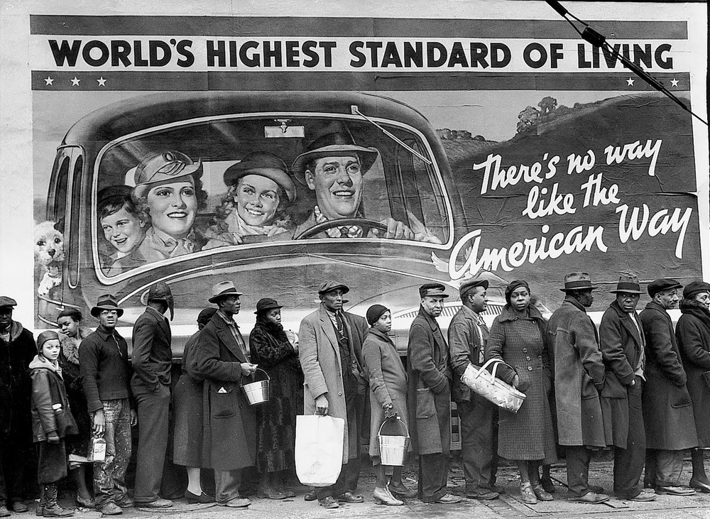
From isolation to World Wat
Describe the historical event in this image
…………………………………………………………………………………………………………………………………………………………………………………………………………………………………………………………………………………………………………………………………………………………………………………………………………………………………………………………………………………………………………………………………………………………………………………………………………………………………………………………………………………………………………………………………………………………………………………………………………………………………………………………………………………………………………………………………………………………………………………………………………………………………………………………………………………………………………………………………………………………………………………………………………………………………………………………………………………………………………………………………………………………………………………………………………………………………………………………………………………………………………………………………………………………………………
Bust – Americans’ experiences of the Depression and New Deal
The various labels say:
The law
Justice
Organized crime
Bootleg profits
Gang rule
Pardon
Bond money
Money to bribe politicians. Money to bribe jurors. Money to beat the law. Money to hire “best” lawyers.
Describe the historical event in this image
……………………………………………………………………………………………………………………………………………………………………………………………………………………………………………………………………………………………………………………………………………………………………………………………………………………………………………………………………………………………………………………………………………………………………………………………………………………………………………………………………………………………………………………………………………………………………………………………………………………………………………………………………………………………………………………………………………………………………………………………………………………………………………………………………………………………………………………………………………………………………………………………………………………………………………………………………………………………………………………………………………………………………………………………………………………………………………………………………………………………………………………………………………………………………………………………………………………………………………………………………………………………………………………………………………….………..

Slide 21
America at war
Define Lend Lease
Define Munitions
Define Tariff
Define Malnutrition
Knowledge questions
Who were Fred Astaire and Ginger Rogers?
Who was Rosie the Riveter?
What did Roosevelt do to banks?
How many people were losing their job every day in 1932?
Dates
When was Roosevelt elected for a second term in office?
When did the USA enter the war?
 |  | Total /10
Bust – Americans’ experiences of the Depression and New Deal
Connect
Describe two reasons why America joined the Second World War.
Corrections – target things to learn
1)
2)
3)

Slide 22
How prosperous were the American people in the 1950s?
When the Second World War ended in 1945, life in the USA began to go back to normal. Peacetime goods were now being produced in the same efficient way that war time good had been produced. Luxury goods, such as vacuum cleaners, fridges, cars and televisions were produced at prices that millions could afford. The public was keen to buy these because they had been so rare during the war years. There was also a huge push on advertising and ‘buy now, pay later’ schemes persuaded people to part with their hard earned cash. The way people shopped also changed. Huge out of town shopping malls were built on the outskirts. People could now buy everything they wanted and needed under one roof. Town and city centers suffered. People stopped shopping on the high street in favor of these huge out of town malls. Massive car parks were built to accommodate the growing number of cars on the roads. By 1956 there were 75 million vehicles on America’s roads.
By the end of the 1950s, nine out of every ten US households had a TV, eight had a car and a telephone and seven had a washing machine. On top of this, Europe was also keen to buy American goods. Europe had been devastated by war and was looking for a way to bring goods into their countries. This made the US economy stronger than ever. Even though they only had 6% of the worlds population, by 1952 America was supplying the world with 65% of manufactured goods. Its growing population was consuming one third of the world’s goods and services. In addition, after the war there was a ‘baby boom’ in America. That created a 40% increase in population.
Post-war America
How does this economic boom of the 50s compare to the economic boom of the 20s? Read the information and bullet point your ideas
Similarities | Differences
Connect
How did the Second World War help America have another economic boom?

Slide 23
Why did the Red Scare strike again? McCarthyism in America
Define McCarthyism
Define Consumerism
Define HUAC
Define Red Scare
Knowledge questions
Name one famous Rock ‘n’ Roll star
What was the spending power of a teenager in the 50s (a week)
Which president was assassinated in 1963?
What did President Johnson raise the minimum wage to?
Dates
When did Roosevelt die?
When was McCarthyism?
 |  | Total /10
Post-war America
Connect
What had rescued the American economy, the New Deal or the Second World War?
Corrections – target things to learn
1)
2)
3)

Slide 24
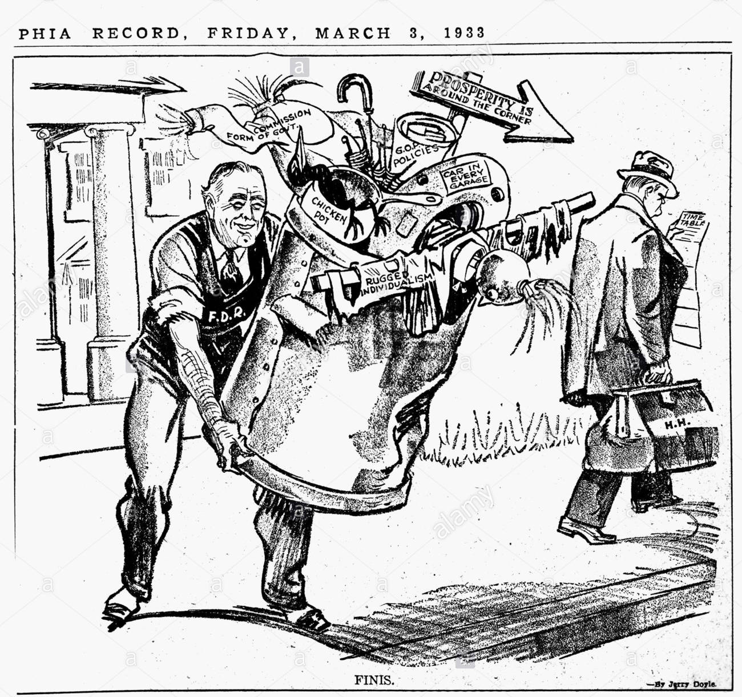
Civil Rights Movement: The early steps
Post-war America
Connect
What is this source describing?

Slide 25
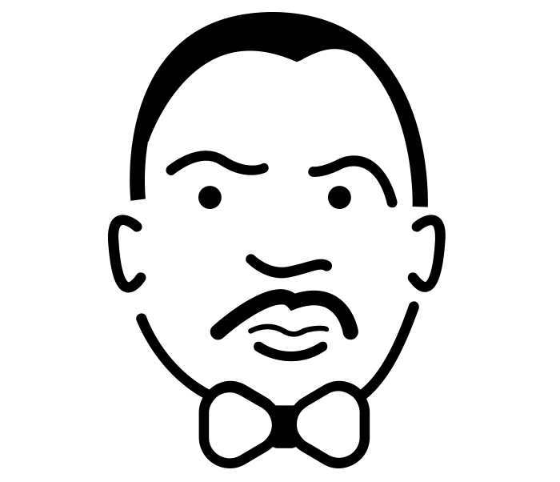
The Civil Rights Movement
Define Civil Rights
Define Montgomery Bus Boycott
Define Sit-in
Define Popular culture
Knowledge questions
What was the name of the Senator who led the Communist witch hunt in the 1950?
What is the name of the legal case used to desegregate schools?
Name the court case they dealt with abortion law in America
Who was Malcom X
Dates
When did Rosa Parks protest on busses?
When was the March on Washington?
 |  | Total /10
Post-war America
Connect
How had African-Americans been treated
In the 1920s
In the Second World War
Corrections – target things to learn
1)
2)
3)

Slide 26
The Black Power movement: a more violent approach to civil rights
Interpretation A: From the webpages of the Rosa and Raymond Parks Institute for Self Development, an organisation co-founded in 1987 by Rosa Parks to inspire young people
Rosa Louise Parks was nationally recognized as the ‘mother of the modern day civil rights movement’ in America. Her refusal to surrender her seat to a white male passenger on a Montgomery, Alabama bus, December 1st 1955, triggered a wave of protest December 5th 1955 that reverberated throughout the United States. Her quiet courageous act changed America, its view of black people and redirected the course of history.
Post-war America
Interpretation B: From Black Profiles in Courage by Kareen Abdul-Jabbar and Alan Steinberg (1996); Abdul-Jabbar thought that school textbooks tend to diminish the achievements of people of colour in history; he wanted to write a book to provide role models for young African-Americans.
Rosa was aware that in the last twelve months alone three African-American females had been arrested for the same offence. Of four black passengers asked to surrender their seats in no-man’s land, two refused – an elderly woman and fifteen-year-old Claudette Colvin. ‘I done paid my dime,’ Colvin had said. ‘I ain’t got no reason to move.’ Colvin refused to move, so police dragged her, fighting and crying, to the squad car, where she was rudely handcuffed.
How are they different? (Inside the box) | Why are they different? (Outside the box)
Connect
Which is the most convincing?
Green for growth

Slide 27
President Kennedy’s ‘New Frontier’
Define Black Power
Define Great Society
Define Black Panther Party
Knowledge questions
Who was Martin Luther King?
Name one thing that women campaigned for in this time period.
What overshadowed President Johnson’s work in this period?
What stopped Kennedy from achieving his aims?
Why did some people move away from MLK and towards Malcom X?
Dates
When was segregation ended in the military?
When were the race riots?
 |  | Total /10
Post-war America
Connect
How successful had Civil Rights been?
Green for growth

Slide 28
President Johnson’s ‘Great Society’
Ultimate recall challenge
Which of these did the Medieval Church not do?
Support the ideas of Galen | Establish universities | Encourage dissection
Who discovered circulation and published his work in 1628?
Harvey | Vesalius | Parè
When did Jenner discover vaccination?
1778 | 1788 | 1798
Who wrote ‘Round About a Pound a Week’ in 1913 highlighting the difficulty of a Labourers wage?
Charles Booth | Sebohm Rowntree | Maude Pember Reeves
In what year did Hitler send troops into the Rhineland?
1936 | 1937 | 1938
Which Prime Minister of Britain followed a policy of Appeasement?
David Lloyd George | Neville Chamberlain | Winston Churchill
Which countries were bared from the League of Nations, select two
USSR | USA | Germany
Which president of the USA was in charge at the time of the Wall Street Crash?
Calvin Coolidge | Herbert Hoover | Franklin D Roosevelt
How many lost their jobs during the Great Depression?
13 million | 13.5 million | 14 million
When was the March on Washington?
1954 | 1960 | 1963
When was segregation made illegal in American schools?
1954 | 1960 | 1963
Post-war America

Slide 29
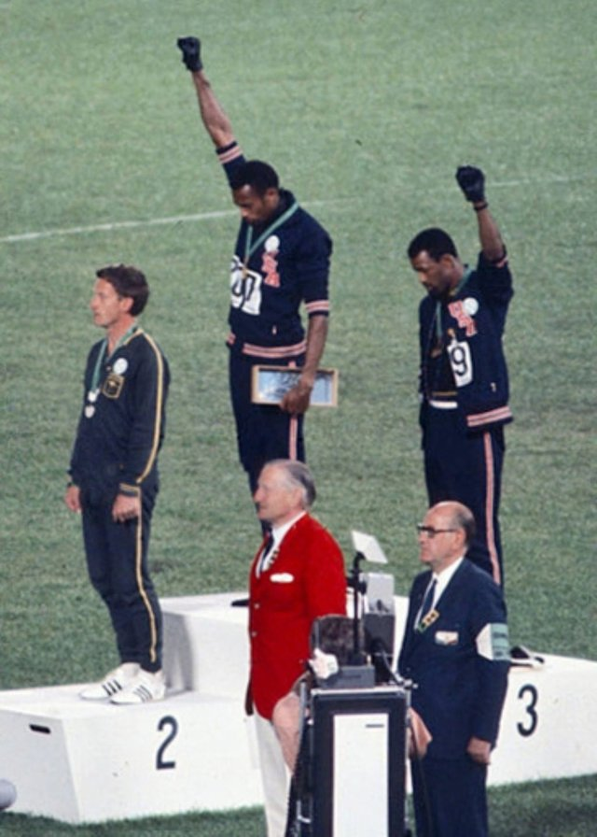
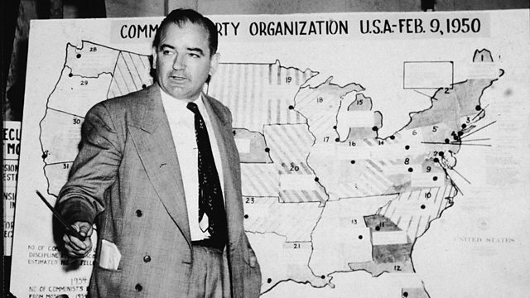
What advances did the feminist movement make in the 1960s and 70s?
Post-war America
Describe the historical event in this image
…………………………………………………………………………………………………………………………………………………………………………………………………………………………………………………………………………………………………………………………………………………………………………………………………………………………………………………………………………………………………………………………………………………………………………………………………………………………………………………………………………………………………………………………………………………………………………………………………………………………………………………………………………………………………………………………………………………………………………………………………………………………………………………………………………………………………………………………………………………………………………………………………………………………………………………………………………………………………………………………………………………………………………………………………………………………………………………………………………………………………………………………………………………………………………
Describe the historical event in this image
…………………………………………………………………………………………………………………………………………………………………………………………………………………………………………………………………………………………………………………………………………………………………………………………………………………………………………………………………………………………………………………………………………………………………………………………………………………………………………………………………………………………………………………………………………………………………………………………………………………………………………………………………………………………………………………………………………………………………………………………………………………………………………………………………………………………………………………………………………………………………………………………………………………………………………………………………………………………………………………………………………………………………………………………………………………………………………………………………………………………………………………………………………………………………………

