Slide 1
Team History
GCSE History
Masters of recall
Conflict and Tension 1918 - 1939
Name: ……………………………………………………………..
Teacher: ………………………………………………………….
“Enabling all individuals to unlock their unique potential”

Slide 2
Every activity that you do in your silent start will be completed in this booklet.
All of the activities are designed to recap knowledge and link knowledge together. It is important that you constantly review your learning and use your knowledge organisers at home.
To be successful in GCSE History, you must know your content inside out. This booklet is the first step on that journey.
 | Topic | Content to focus on
Peacemaking
Lessons 1 - | The armistice: aims of the peacemakers
 | The Versailles Settlement
 | Impact of the treaty and wider settlement
The League of Nations and international peace
Lessons - | The League of Nations
 | Diplomacy outside the League
 | The collapse of the League
The origins and outbreak of the Second World War
Lessons - | The development of tension
 | The escalation of tension
 | The outbreak of war

Slide 3
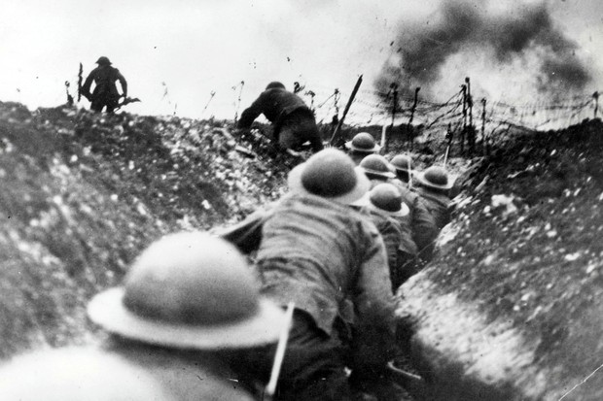
The Big Three: the men who shaped the peace.
Using the information sheet and your own knowledge, create a spider diagram about what the first World War was like.
Treaty of Versailles
WW1
Connect
What medical developments happened during WW1?
Green for growth

Slide 4
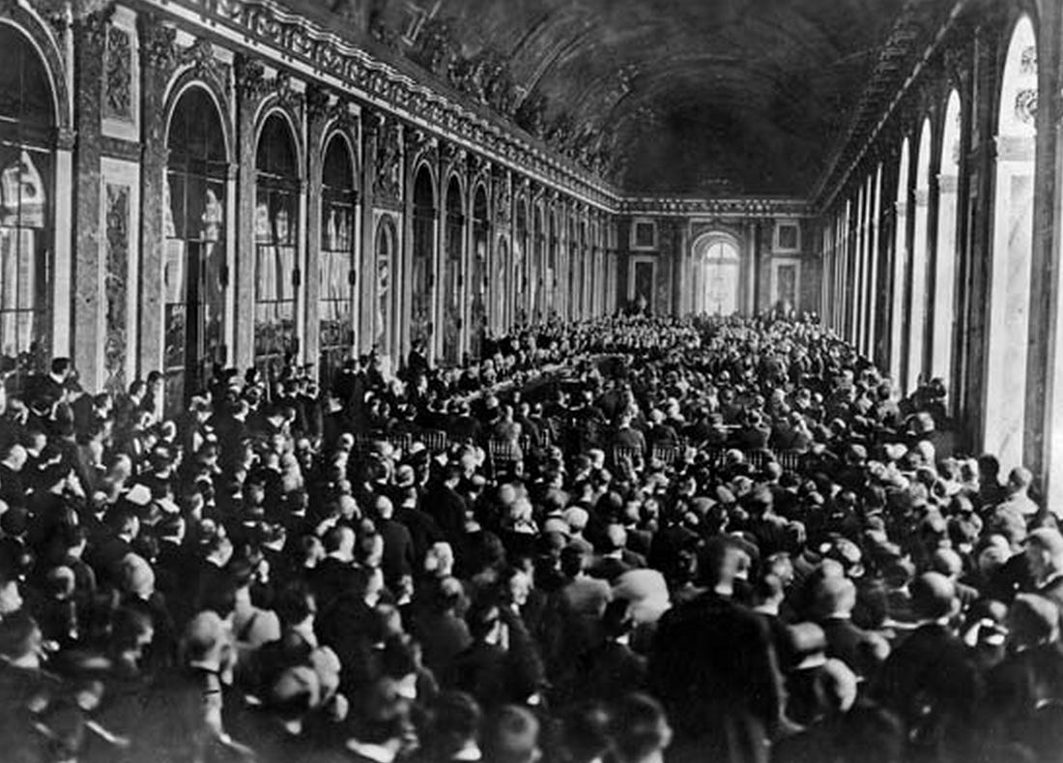
The Terms of the Treaty of Versailles
Treaty of Versailles
What do you think is happening here?
……………………………………………………………………………………………………………………………………………………………………………………………………………………………………………………………………………………………………………………………………………………………………………………………………………………………………………………………………………………………………………………………………………………………………………………………………………………………………………………………………………………………………………………………………………………………………………………………………………………………………………………………………………………………………………………………………………………………………………………………………………………………………………………………………………………………………………………………………………………………………………………………………………………………………………………………………………………………………………………………………………………………………………………………………………………………………………………………………………………………………………………………………………………………………………………………………………………………………………………………………………………………………………………………………………….………..
Predict – what sort of peace treaty do you think will be created by the Big Three?
Green for growth

Slide 5
Reactions to the Treaty of Versailles
German outrage
When the Germans heard about the Treaty of Versailles, they felt ‘pain and anger’. They felt it was unfair. It was a 'Diktat' – an IMPOSED settlement. They had not been allowed to take part in the talks – they had just been told to sign.
The German reaction
On 7 May, the victors presented their Treaty to the small German delegation. Count Brockdorff-Rantzau angered the Big Three by giving a long speech criticising the Treaty; then the delegation left and set about countering it. A little later, they sent their counter-proposal based on the Fourteen Points) to the Big Three -- their reply was so good that one of the British delegation said it was much better than the Allies' suggestions, and even Lloyd George wondered for a time if they ought to rethink the treaty . Then the delegation went home. Many Germans wanted to refuse to sign the treaty; some even suggested that they start the war again. So it was with great difficulty that the President got the Reichstag to agree to sign the treaty, and the imperious way the two German representatives were treated when they were forced to sign made things worse.
Treaty of Versailles
Summarise what Germany thought about the Treaty of Versailles
Connect
Green for growth

Slide 6
How fair was the Treaty of Versailles and the wider settlement on Germany and its allies?
Treaty of Versailles
Connect – Which leader was the most satisfied with the Treaty of Versailles?

Slide 7
The League of Nations - Structure of the League of Nations
The League of Nations
Connect – How is the League of Nations connected to the Treaty of Versailles?

Slide 8
Successes of the League of Nations
Define Demilitarise
Define Abdicate
Define Colony
Define Danzig
Knowledge questions
How many men were killed during the fighting of the First World War?
What was the Covenant of the League of Nations?
What were the powers of the League of Nations?
What is the modern name of the Health Commission of the League of Nations?
Dates
In what year was the Locarno Pact signed?
In what year did Germany join the League of Nations?
 |  | Total /10
The League of Nations
Corrections – target things to learn
1)
2)
3)
Green for growth

Slide 9
International agreements and the impact of the Depression on the League of Nations.
Define Fontainebleau Memorandum
Define Moral Condemnation
Define Veto
Define Depression
Knowledge questions
What were the aims of the League of Nations (4)
What did the League of Nations force Greece to do in 1925?
Where was the League of Nations based?
What else was based in the same city as the League of Nations?
Dates
In what year was the Wall Street Crash?
In what year were did the L of N ban lead based paint?
 |  | Total /10
The League of Nations
Connect: Explain how the League of Nations and Treaty of Versailles are connected.
Corrections – target things to learn
1)
2)
3)

Slide 10
Why was there a crisis in Manchuria?
Define Collective Security
Define Fascist
Define Mitigation
Define Permanent Court of Justice
Knowledge questions
Who was Lord Lytton?
Why didn’t America join the League of Nations?
What did the Kellogg-Briand Pact agree?
What was Japan suffering from in 1932?
Dates
In what year was the Manchurian Crisis?
In what year was the Fontainebleau Memorandum signed?
 |  | Total /10
The League of Nations
Connect: Explain why countries like Germany were now being allowed to join the League of Nations
Corrections – target things to learn
1)
2)
3)

Slide 11
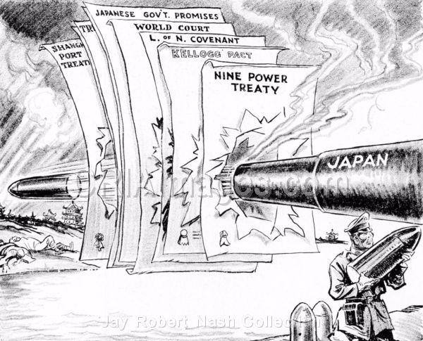
Bonus starter, just in case
The League of Nations
This cartoon was produced in 1933
What is the cartoon saying about Japan?

Slide 12
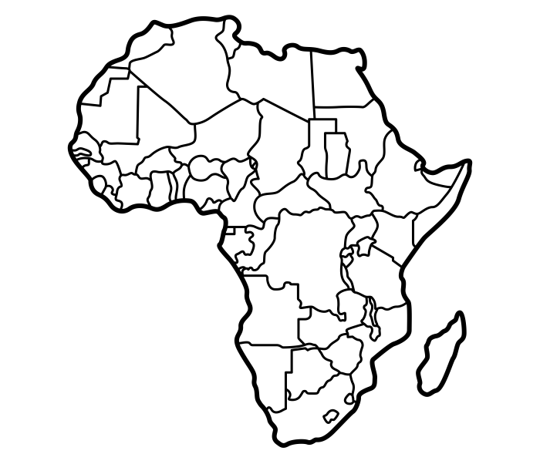
Why was there a crisis in Abyssinia?
Define Unanimous
Define Stresa Front
Define Economic Sanctions
Define Council
Knowledge questions
Who was Samuel Hoare?
Who was Pierre Laval?
Which country has a leader called Haile Selassie?
What was the Lytton Commission?
Dates
In what year was the Abyssinian Crisis?
In what year was Hitler elected?
 |  | Total /10
The League of Nations
Corrections – target things to learn
1)
2)
3)

Slide 13
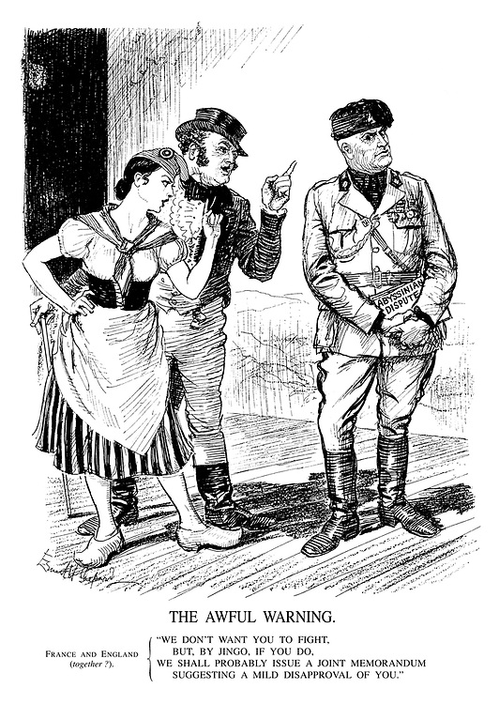
Bonus starter, just in case
The League of Nations
What is the cartoon saying about Japan?

Slide 14
Why did the League of Nations fail?
Ultimate recall challenge
Which article blamed Germany for the war?
230 | 231 | 232
Which area was given to the L of N for 15 years?
Rhineland | Alsace-Lorraine | Saar
When was the Treaty of Versailles signed?
June 1919 | July 1919 | August 1919
Which Treaty dealt with Austria Hungary?
Lausanne | St. Germain | Neuilly
How many German speakers were displaced by the Treaty of Versailles?
6million | 7 million | 8 million
Who was sent to investigate the Manchurian Crisis?
Samuel Hoare | Lord Lytton | Pierre Laval
Which of these was banned from the League of Nations at the start?
America | Japan | USSR
Which of these was not done in the Abyssinian Crisis?
Close the Suez Canal | Economic sanctions | Moral condemnation
Who developed Carbolic Acid?
Simpson | Lister | Davy
In which year was London’s first hospital opened?
1103 | 1113 | 1123
What was added to blood to enable blood transfusion?
Sodium Chloride | Sodium Citrate | Sodium
The League of Nations

Slide 15
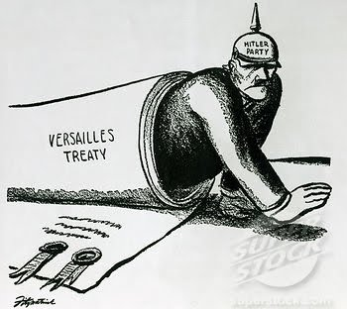
The aims of Adolf Hitler
Hitler’s foreign policy
Explain what this cartoon is trying to say about German reactions to Versailles and Hitler’s attitude towards it?

Slide 16
World leaders and the first steps towards the Second World War
Each box contains factual information but with a mistake. Use your knowledge to correct the mistake in each box.
The League of Nations was the idea of the French leader Woodrow Wilson. | The Treaty of Versailles forced Germany to pay 600,000 in reparations.
When the League of Nations was founded, there were 48 members. This rose to 57 by 1934. | In 1921 a plebiscite was held in upper Silesia. German police officers were outside the polling stations to make surer voting was fair.
The Kellogg-Brie pact, 1928 saw 65 countries agree that they wouldn’t use war to deal with disputes. | Hitler was able to use the depression to get elected in Germany using slogans like ‘Arbeit und Käse‘.
The Treaty of Lausanne showed it was possible to overturn a harsh treaty. This was shown when Hungary was able to cancel the reparations that had been demanded. | In 1928 the Wall Street Drop happened. This devastated the economies of countries around the world.
A British politician called Earl Lytton investigated the Manchurian Crisis on behalf of the League.
Hitler’s Foreign Policy
Corrections – target things to learn
1)
2)
3)

Slide 17
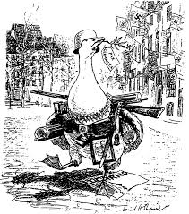
The Remilitarisation of the Rhineland
Define Foreign policy
Define Volksdeutsche
Define Remilitarisation
Define Fuhrer
Knowledge questions
Who was Neville Chamberlain?
What was the name of the book that Hitler laid out his aims in?
What is the German word for ‘living space’ in the east?
What did Hitler think of Communism?
Dates
In what year was the Disarmament conference?
In what year was the Rome-Berlin Axis signed?
 |  | Total /10
Hitler’s Foreign Policy
Connect: Have a think, would Hitler have been elected if the Treaty of Versailles had never existed?
Corrections – target things to learn
1)
2)
3)

Slide 18
World leaders and the first steps towards the Second World War
Answer as many of the questions as you can. Write you answer in the box with the question.
Total?
Hitler’s Foreign Policy
Corrections – target things to learn
1)
2)
3)

Slide 19
Anschluss – The unification of Germany and Austria, 1938
Define Quack Doctor
Define Luftwaffe
Define Lebensraum
Define Antibiotic
Knowledge questions
Who was Kurt Schuschnigg?
Who warned Hitler against remilitarising the Rhineland?
Which country was Hitler born in?
Which name is given to Russia in this time period?
Dates
In what year was the Abyssinian Crisis?
In what year was the Rearmament rally?
 |  | Total /10
Hitler’s Foreign Policy
Connect: Would Hitler have tried to conquer other countries if Britain and France had taken a stand over the Rhineland?
Corrections – target things to learn
1)
2)
3)

Slide 20
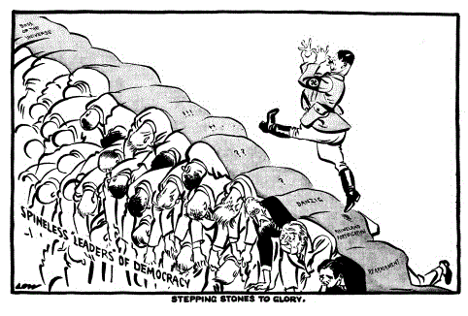
Bonus starter, just in case
Hitler’s Foreign Policy
What is the cartoon saying about Hitler?
What is the cartoon saying about other world leaders?

Slide 21
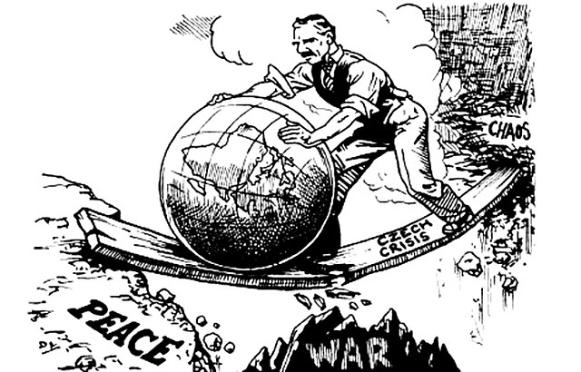
Why was there a crisis in the Sudetenland?
Define Pacifist
Define Satirical
Define Greater Germany
Define Pact
Knowledge questions
Who was Arthur Seyss-Inquart?
Who was Edvard Benes?
Which policy was applied by Britain and France in the Sudeten Crisis?
What were the French distracted with during the 1936 Abyssinian Crisis?
Dates
In what year was the Anschluss?
In what year was the Munich Agreement?
 |  | Total /10
Hitler’s Foreign Policy
Connect: Why do you think Anschluss is sometime called ‘blumenkrieg’ which translates as ‘war of flowers’?
Corrections – target things to learn
1)
2)
3)

Slide 22
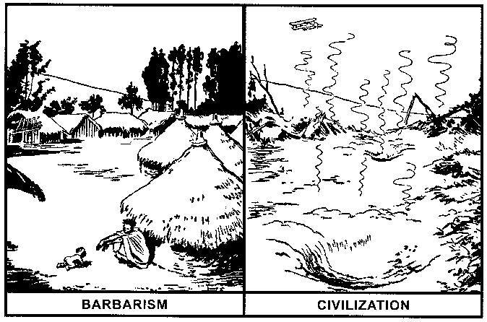
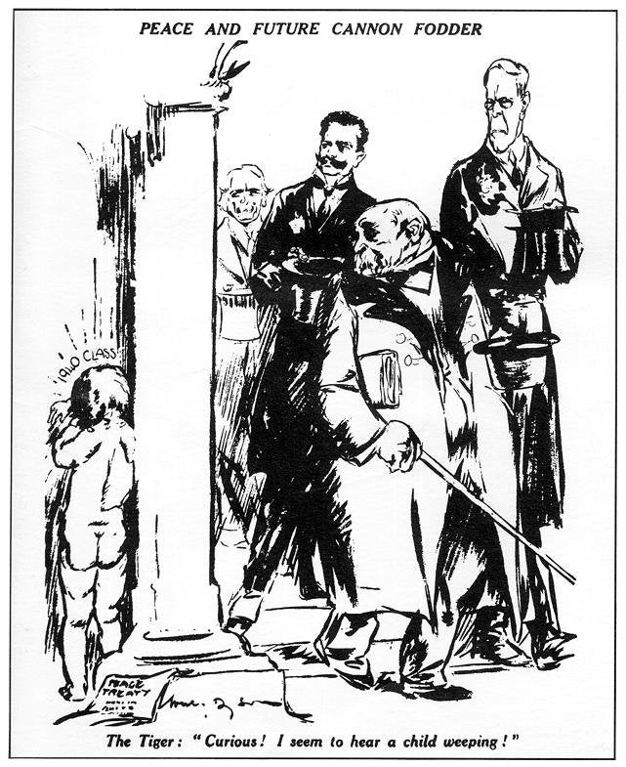
Why was there a crisis in the Sudetenland?
The year is 1936. The modern day name for the country involved is Ethiopia.
Hitler’s Foreign Policy
Describe the historical event in this image
……………………………………………………………………………………………………………………………………………………………………………………………………………………………………………………………………………………………………………………………………………………………………………………………………………………………………………………………………………………………………………………………………………………………………………………………………………………………………………………………………………………………………………………………………………………………………………………………………………………………………………………………………………………………………………………………………………………………………………………………………………………………………………………………………………………………………………………………………………………………………………………………………………………………………………………………………………………………………………………………………………………………………………………………………………………………………………………………………………………………………………………………………………………………………………………………………………………………………………………………………………………………………………………………………………….………..
Describe the historical event in this image
……………………………………………………………………………………………………………………………………………………………………………………………………………………………………………………………………………………………………………………………………………………………………………………………………………………………………………………………………………………………………………………………………………………………………………………………………………………………………………………………………………………………………………………………………………………………………………………………………………………………………………………………………………………………………………………………………………………………………………………………………………………………………………………………………………………………………………………………………………………………………………………………………………………………………………………………………………………………………………………………………………………………………………………………………………………………………………………………………………………………………………………………………………………………………………………………………………………………………………………………………………………………………………………………………………………………………………….………..

Slide 23
Bonus starter, just in case
Hitler’s Foreign Policy
What is the cartoon saying about the role of Neville Chamberlain?
Do you think it is being positive or negative about Chamberlain?

Slide 24
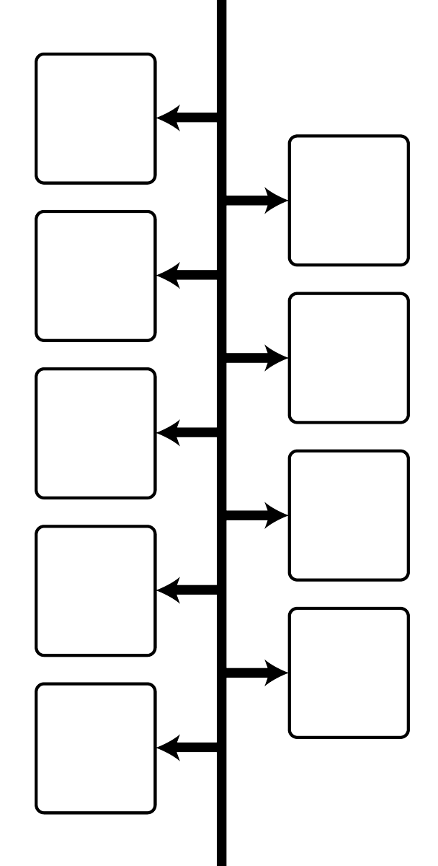
Was Chamberlain right to follow a policy of Appeasement?
Place the following events on the timeline in the correct chronological order and give the year that they happened.
World War Two | Remilitarisation of the Rhineland | Munich Agreement
Rome-Berlin Axis signed | Invasion of Czechoslovakia | Invasion of Poland
Nazi-Soviet Pact | Disarmament conference | Anschluss
Hitler’s Foreign Policy

Slide 25
Exam question lesson
In the list below colour code:
Events in Europe which pressurised Chamberlain to change his policy of appeasement.
Events in England which pressurised Chamberlain to change his policy of appeasement.
Events which showed that Britain was preparing for war all the time.
1938 | Chamberlain signs the Munich Agreement.
3 October | Duff Cooper, First Lord of the Admiralty, resigns over Munich.
27 October | Quentin Hogg, a Chamberlain supporter, wins a by-election in Oxford, but his opponent is supported by many Conservatives (including Winston Churchill), who claim: ‘A vote for Hogg is a vote for Hitler’.
8 November | Kristallnacht – Nazis attack the German Jews. Hitler begins to persecute the Jews in Germany.
1 December | Britain sets up a ‘National Register’ of who would do what if there was a war.
3 January 1939 | The British navy is made stronger. The RAF increases production of planes to 400 a month.
15 February | Parliament increases defence spending to £580 million a year. A quarter of a million free air raid shelters are given to Londoners.
28 February | The Fascist ruler Franco wins the Spanish Civil War. British MPs shout ‘Heil Chamberlain’ in Parliament.
15 March 1939 | Hitler invades Czechoslovakia; Chamberlain says it is a ‘shock to confidence’. This is the first time Hitler has attacked a non-German people.
29 March | The Territorial Army is doubled in numbers.
30 March | Britain and France promised to give the Polish government 'all support in their power' if Poland was attacked.
5 April | A Civil Defence Act is passed; it plans to evacuate women and children from London to the countryside.
13 April | Mussolini (the Fascist ruler of Italy) conquers Albania.
25 April | Parliament votes to spend £1,322 million on defence.
28 April | Germany renounces the German-Polish Non-Aggression Pact of 1934 and the London Naval Agreement of 1935.
1 May | The Military Training Act introduces conscription in Britain.
19 May | Stalin suggests an alliance of France, Britain and Russia against Hitler.
22 May | Pact of Steel: Hitler and Mussolini make an alliance of support in the event of a war.
11 August | British politicians go to Moscow to make the alliance with Russia.
23 August | Russia and Germany sign a treaty, not to go to war with each other, and to attack and divide Poland between them.
25 August | Britain signs a Common Defence Pact with Poland, promising to send military aid if Poland is attacked; hearing of it, Hitler postpones the invasion of Poland he had planned for 26 August.
26 August | Hitler sends 2000 armed Nazis to Danzig to stir up trouble, then demands Danzig and the Polish corridor.
26 August | Hitler offers to defend the British Empire if Britain lets him have Danzig and all former German colonies. Britain replies that it is 'willing in principle to come to an agreement with Germany’, but was committed to fight if Germany attacked Poland.
31 August | The first children are evacuated from London.
1 September | Hitler invades Poland.
3 Sept 1939 | Britain declares war on Germany.

Slide 26
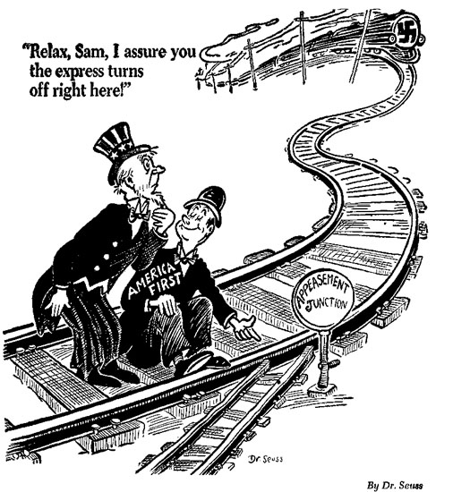
The Nazi Soviet Pact
Hitler’s Foreign Policy
What is the cartoon saying about the policy of appeasement and the Second World War?
Do you think the cartoon is useful to a historian for understanding views about appeasement?

Slide 27
How did the invasion of Poland start the Second World War?
1) Each box contains factual information but with a mistake. Use your knowledge to correct the mistake in each box.
George Clemenceau believed in the principle of self-determination. | Failure to close the Manchester Ship Canal allowed Mussolini to move troops to the area.
The Assembly had the power of Veto and could stop decisions in their tracks. | British Prime Minister, Churchill, used a policy of appeasement when dealing with Hitler.
The treaty that dealt with Hungary was the Treaty of Sevres. | The Mukden Incident saw Italy create an excuse to invade Manchuria.
The Remilitarisation of the Rhineland took place in 1935. | 11th March 1938 Seyss-Inquart was replaced by Schuschnig in Austria.
The Saar was demilitarised under the 1919 settlement.
Hitler’s Foreign Policy
2) Colour code the facts into the three categories.
Peacemaking
League
Hitler
Corrections – target things to learn
1)
2)
3)

