Slide 1
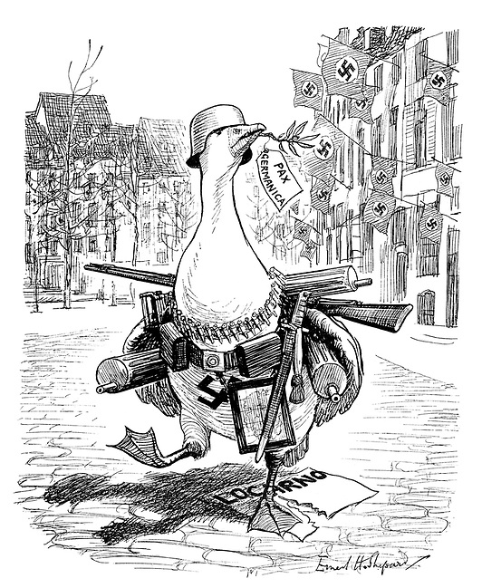
GCSE History
Revision booklet
Conflict and tension: The inter-war years, 1918–1939
Team History
Name: ……………………………………………………………………….………………..
Teacher: ……………………………………………………………………..……………….

Slide 2
Instructions for using the revision guide
Team History
This revision guide will be your homework throughout the year. You will be set one piece of revision per week, to be completed in this booklet.
QR Codes
Throughout the booklet there are a number of QR codes which will take you to other helpful sites/resources to aid your revision. You will need to download a QR scanner on your phone to make sure you can access the material.
Seneca
There are lots of resources available for our course on Seneca. These will be embedded with QR codes. You will need to join our class; the code to join our class is ……………………..
Loom
Where possible, your teachers have recorded information about the topic on Loom videos. These are linked in the QR codes. If you are struggling, access them to help you.
Video
There are lots of useful videos and revision clips on YouTube and BBC bitesize. Your teacher will, where possible link these with the QR codes.
B
B
C

Slide 3
Knowledge check list
Topic | I can explain | Red | Amber | Green
Peacemaking after the First World War | Aims of the Big Three?
 | Terms of the Treaty of Versailles?
 | German reaction to the Treaty of Versailles
 | Reaction of the ‘Big Three’ to the Treaty of Versailles
 | How fair was the Treaty of Versailles?
 | How were Germany’s allies treated at the end of the war?
 | How far the ‘Big Three’ achieved their aims
Topic | I can explain | Red | Amber | Green
The League of Nations and international peace | Why was the League of Nations created?
 | What was the structure of the League?
 | Did the League of Nations help people?
 | How successful was the League in the 1920s? (Corfu, Bulgaria, Wall Street Crash and the Depression)
 | How did international agreements help the League of Nations?
 | What happened during the Manchurian Crisis?
 | How did the League of Nations react to the Manchurian Crisis?
 | Why did Italy invade Abyssinia?
 | How did the League respond to the Abyssinian crisis?
 | Was the League of Nations destined to fail?

Slide 4
Knowledge check list
Topic | I can explain | Red | Amber | Green
The origins and outbreak of the Second World War | Hitler’s aims
 | How did other countries react to Hitler’s foreign policies?
 | How did Hitler rearm Germany?
 | What was the road to war (timeline of events)?
 | How was the Rhineland remilitarised?
 | Which countries supported Hitler?
 | How did Hitler achieve the Anschluss with Austria?
 | What was the Sudeten Crisis?
 | Why was Chamberlain so hopeful of peace in our time?
 | How did Britain and France react to Hitler’s actions?
 | Was appeasement a good idea?
 | Why was appeasement a bad idea and where can we see it in action?
 | The Nazi Soviet Pact
 | The consequences of the Nazi Soviet Pact
 | Why did the Second World War break out?

Slide 6
Peace conference
Aims of Big 3
1) Complete the table to show the aims of the ‘Big Three’ at the Paris Peace talks. Make sure you complete all of the boxes.

Slide 7
2) Read the speech bubbles carefully and complete the task
Peace conference
Aims of Big 3
7

Slide 8
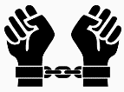
Background
3) Match the keyword to the definition and answer the questions.
Key word: | Definition:
Military restrictions | a decree forced upon someone regardless of whether they like it or not.
Territorial changes | alterations to the ownership of areas of land.
Reparations | limiting the amount of soldiers or armed forces.
Diktat | accepting the blame for starting the war.
War guilt | compensation for war damage that is paid by a defeated country.
Key facts: In 1919 the Treaty of Versailles was signed by the victorious countries at the Palace of Versailles near Paris. It dealt only with Germany. Two representatives of the new German government were summoned. The Germans had been allowed no say in the discussions. They were simply invited to agree to the ‘diktat’ (dictated peace) that was forced upon them.
Why were the German representatives not allowed a say in the treaty?
………………………………………………………………………………………………………………………………………………………………..
………………………………………………………………………………………………………………………………………………………………..
………………………………………………………………………………………………………………………………………………………………..
………………………………………………………………………………………………………………………………………………………………..
Why did Germany have to accept blame for starting the war?
………………………………………………………………………………………………………………………………………………………………..
………………………………………………………………………………………………………………………………………………………………..
………………………………………………………………………………………………………………………………………………………………..
………………………………………………………………………………………………………………………………………………………………..
8

Slide 9
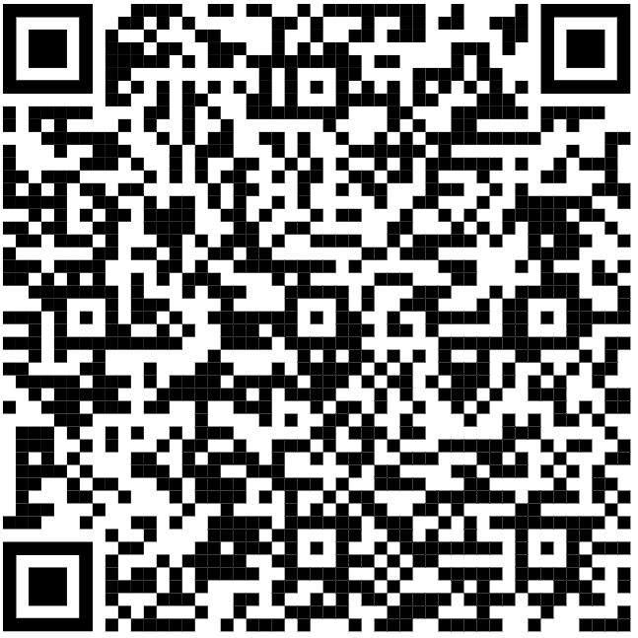
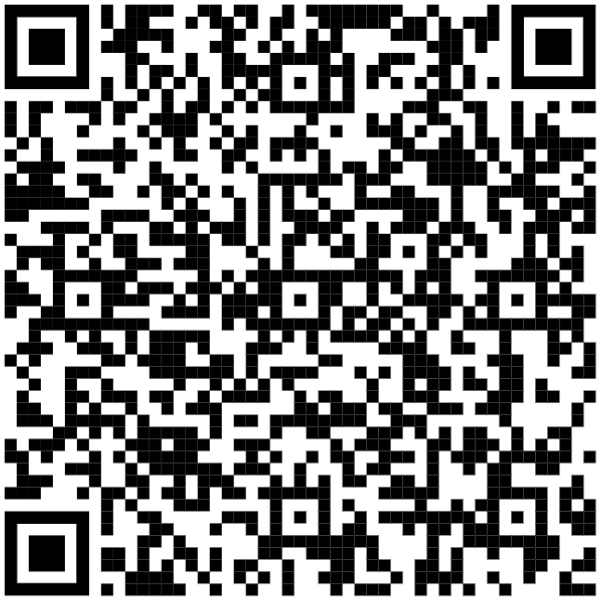
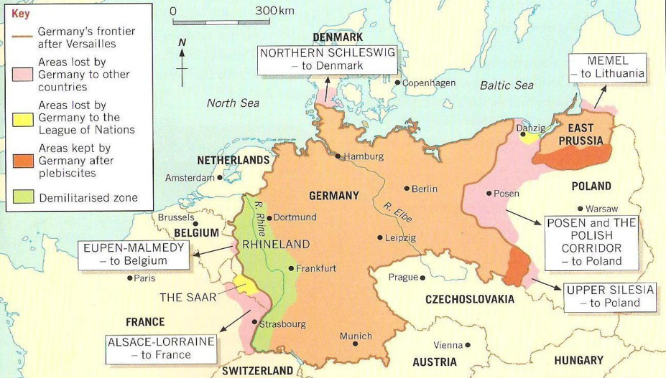
BBC Bitesize
Terms 1
Terms 2
B
B
C
4) Next to each of the terms of the Treaty of Versailles add the category it belongs to. The categories are:
● Territorial changes TC ● Military restrictions MR ● War Guilt WG ● Reparations R.
Tip: Use the Qr codes and the map to help you
Term of the treaty: | Category:
The War Guilt Clause (Article 231) forced Germany to accept responsibility for starting the war.
Alsace and Lorraine were returned to France. They had been French before 1871. See the map on page 7.
The size and power of Germany’s armed forces were a major concern of all the powers, especially France. To solve this, the treaty limited the army to 100,000 men. Conscription was also banned; all soldiers had to be volunteers.
West Prussia was given to Poland. This meant East Prussia was separated from the rest of Germany by Polish land (Germany was divided into two). See map.
Germany was not allowed tanks, submarines or military aircraft. The navy could only have six battleships.
The Rhineland, a strip of land on the border between Germany and France, became a demilitarised zone. This meant that no German troops were allowed in this area, near the French border. See map. | MR
Germany had to pay for the damage caused by the war. The sum was not fixed in the Treaty, but was later set in 1921 at the huge figure of £6600 million. Germany was supposed to pay a certain amount each year- originally for 42 years.
Germany was forbidden to unite with Austria. See map.
Germany’s colonies in Africa were taken away. Former German colonies became mandates controlled by the League of Nations, which effectively meant that Britain and France controlled them.
The League of Nations was to control the Saar for 15 years, but France controlled the coalfields.

Slide 10
5) Use the table from the previous page to help you answer the exam question.
Write an account of the terms of the Treaty of Versailles [8 marks]
The first paragraph has been done for you as a model for the other paragraphs.
Tips: To complete the answer you need:
Two other paragraphs on different categories of the treaty
Keep focused on the question.
Use at least four specific facts in each paragraph.
Explain how facts relate to the question set.
Have two structured PEE paragraphs.
Paragraph 1: War Guilt and Reparations
Model paragraph: The terms of the Treaty of Versailles included the War Guilt Clause (Article 231). This forced Germany to accept responsibility for starting the war. It justified all the other punishments in the treaty. If Germany was to blame for the war, then it would have to compensate for all the damage that was caused. This included reparations. The sum was not fixed in the treaty, but was later set in 1921 at the huge figure of £6600 million. These terms of the treaty put the blame and punished Germany for World War I.
Paragraph 2: Military restrictions
Paragraph 3: Territorial changes
Use the knowledge organiser to help you add specific detail to your answer.

Slide 11
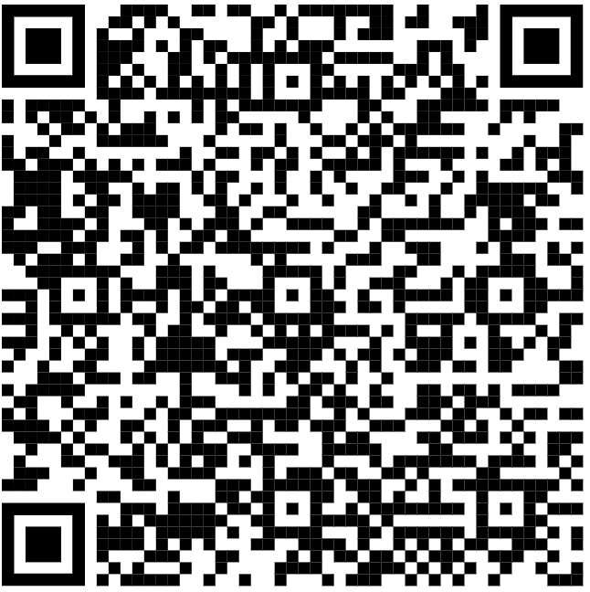
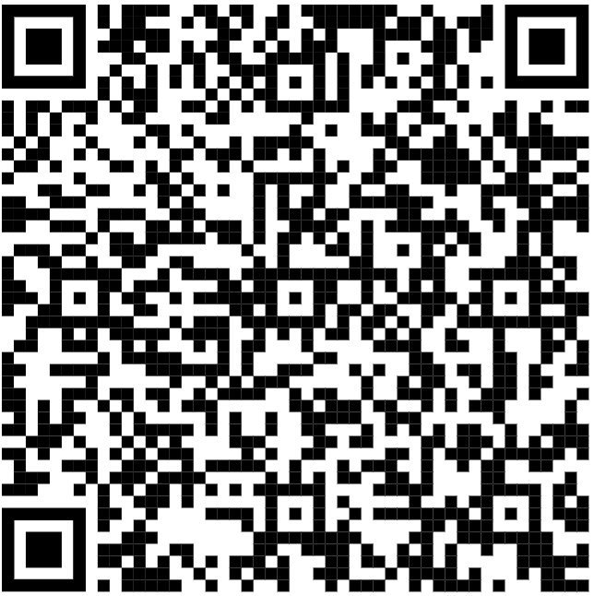
Ger & Fr reaction
GB & USA reaction
Bitesize video
B
B
C
6) Complete the table to show how satisfied each of the ‘Big Three’ were with the terms of the Treaty of Versailles
Aims of the Big Three | USA- Wilson wanted to keep peace
 | France- Clemenceau wanted revenge and security
 | Britain- Lloyd George wanted revenge, but to avoid war in future and trade.
 | What terms did he like? (Satisfied) | What terms did he not like? (Not satisfied) | How far did he achieve his aims?
Woodrow Wilson |  | Disarmament only for Germany and so was unfair Wilson felt that the Treaty was so harsh that Germany would seek revenge and another war would follow. | /10 This is because
Georges Clemenceau |  | Although Clemenceau liked a lot of the terms, he did not think the treaty was harsh enough: Clemenceau wanted Germany to be destroyed, not just weakened Clemenceau felt Germany should not be allowed any army at all It is estimated that the war had cost France 200 billion Francs; the reparations were far less than this | /10 This is because
David Lloyd George | ●Lloyd George was elected PM in 1918 because he promised to ‘Make Germany pay.’ | Lloyd George worried that the Treaty was too harsh and that Germany would seek revenge. The German economy was crippled by the war and reparations. Germany was not in a strong position to trade with anyone. | /10 This is because

Slide 12
7) Complete the table to show the reaction of the German people to the Treaty of Versailles. You need to put them in order of causing the most to least anger.
The terms are:
Diktat, War guilt, Reparations, Territorial losses, 14 points, Disarmament
You must explain how/why each of the terms angered the German people.
Ger & Fr reaction
Part of the treaty that would have caused the most anger: | 1)
 | 2)
 | 3)
 | 4)
 | 5)
Part of the treaty that would have caused the least anger. | 6)
Exam question
Write an account of how the Treaty of Versailles caused problems for Germany.
(8 marks)

Slide 13
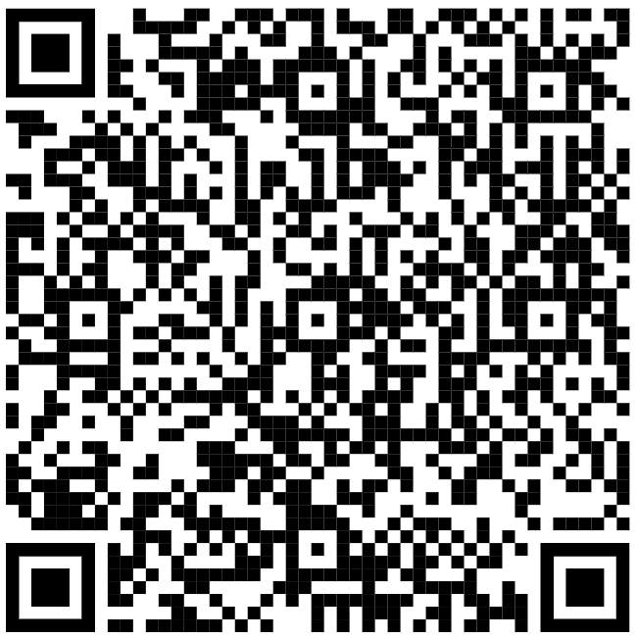
Topic test
8) Read the statements and add them to the correct side of the diagram to show if they are a strength or weakness of Versailles.
Stretch yourself: Add an extra strength and/or weakness. Look back at the terms of the Treaty in this workbook or on the Knowledge Organiser so that you can use specific facts.
The Treaty of Versailles did bring peace at the end of the most devastating war that the world had seen. The League of Nations was also set up to keep peace in the future. | When the American government refused to sign the Treaty and did not join the League of Nations, the whole settlement was less secure.
The Germans thought the Treaty would be based on Wilson’s Fourteen Points. If they had known that so few of these would make it through to the final Treaty, they may not have signed the armistice. | The Treaty punished Germany enough to want revenge, but not enough to stop her from recovering. Germany remained one country with a population of 60 million compared to 40 million of France.
The causes of the First World War were very complex, yet Germany was forced to accept full responsibility. Causes such as the arms race, where Britain and Germany competed to have the biggest navy and empires, were not Germany’s fault alone. | It was normal for the losers of a war to agree to harsh terms. During the war Germany had made Russia sign a treaty that took away more than a quarter of its farmland and population. This shows if Germany had won the war they would have treated the Allies even harsher.
The Rhineland was demilitarised, so no German troops were allowed into this area near the French border. This made France feel more secure. | Many people across the world said that the Treaty was too harsh and that it would lead to another war. Lloyd George predicted there would be another war in just 25 years.
With its economy destroyed by the war, the reparations crippled Germany even more. German hatred of the treaty also created a general resistance to paying. In 1921 French, British and Belgium troops had to invade the Ruhr (an industrial area of Germany) to force the Germans to pay reparations. | Germany lost 10% of its land. German families were forced off land they had owned for generations as it was claimed by other countries under the terms of the Treaty. Other Germans found themselves under foreign control and feared persecution, especially as Germany had been forced to accept the ‘War Guilt Clause.’
STRENGTHS WEAKNESSES

Slide 16
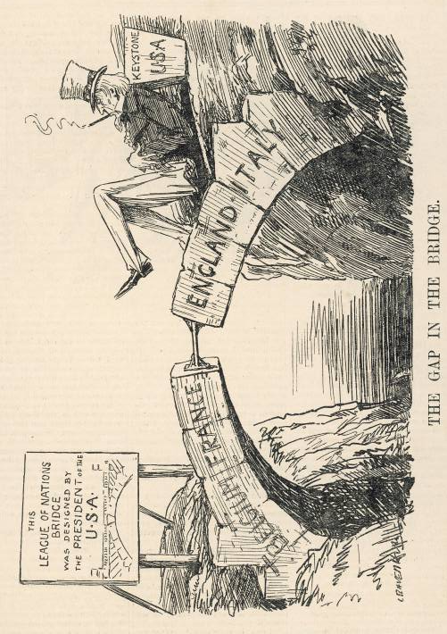
What did Britain and France think of the League of Nations?
…………………………………………………………………………………………………………………………………………………………………………………………………………………… ……………………………………………………………………………………………………………………………………………………………………………………………………………………
……………………………………………………………………………………………………………………………………………………………………………………………………………………
……………………………………………………………………………………………………………………………………………………………………………………………………………………
Overview of L of N
Why didn’t America join the League of Nations?
…………………………………………………………………………………………………………………………………………………………………………………………………………………… ……………………………………………………………………………………………………………………………………………………………………………………………………………………
……………………………………………………………………………………………………………………………………………………………………………………………………………………
……………………………………………………………………………………………………………………………………………………………………………………………………………………
Who’s idea was the League of Nations and why was it formed?
…………………………………………………………………………………………………………………………………………………………………………………………………………………… ……………………………………………………………………………………………………………………………………………………………………………………………………………………
……………………………………………………………………………………………………………………………………………………………………………………………………………………
……………………………………………………………………………………………………………………………………………………………………………………………………………………
Who was excluded from the League of Nations and why? …………………………………………………………………………………………………………………………………………………………………………………………………………………… ……………………………………………………………………………………………………………………………………………………………………………………………………………………
……………………………………………………………………………………………………………………………………………………………………………………………………………………
……………………………………………………………………………………………………………………………………………………………………………………………………………………
10) Membership of the League of Nations. Use this source to help you answer the questions around it.

Slide 17
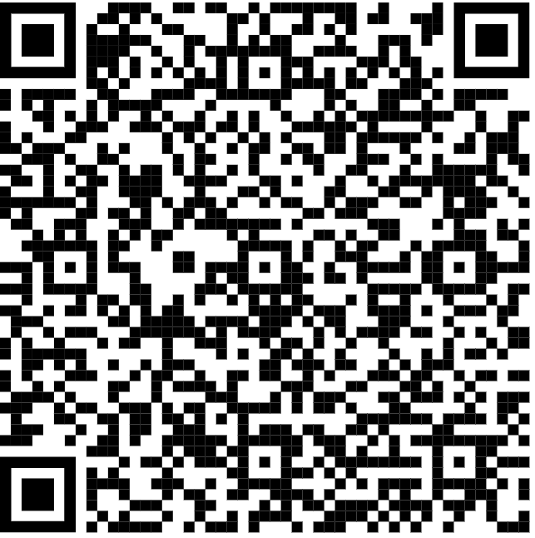
11) Complete the structure of the League of Nations diagram.
Make sure you include the following keywords in your explanations of what each part of the structure did.
Unanimous
Veto
International Labour Organisation
Slavery
Refugee
Assembly
Commissions
The Secretariat
This was the civil service that did all of the paperwork for the League of Nations. They organised everything except military issues.
The Council
…………………………………………………………………………………………………………………………………………………………………………………………………………………………………………………………………………………………
……………………………………………………………………………………………………………………………………………
……………………………………………………………………………………………………………………………………………
……………………………………………………………………………………………………………………………………………
……………………………………………………………………………………………………………………………………………
The Assembly
…………………………………………………………………………………………………………………………………………………………………………………………………………………………………………………………………………………………
……………………………………………………………………………………………………………………………………………
……………………………………………………………………………………………………………………………………………
……………………………………………………………………………………………………………………………………………
……………………………………………………………………………………………………………………………………………
The Permanent Court of Justice
……………………………………………………………………………………………………………………………………………………………………………………………………………………………………………………………………………………………………………………………………………………………………………………………………………………………………………………………………………………………………………………………………………………………………………………………………………………..
Special commissions
……………………………………………………………………………………………………………………………………………………………………………………………………………………………………………………………………………………………………………………………………………………………………………………………………………………………………………………………………………………………………………………………………………………………………………………………………………………..

Slide 18
12) Annotate the source. Use your classwork about how the League of Nations helped people through their special commissions and any areas that they were successful in the 1920s. You are looking for examples of good thing’s that the League achieved.
An American cartoon
Exam question ‘Write an account of how the League of Nations tried to deal with international conflict in the 1920s.’ (8 marks)

Slide 19
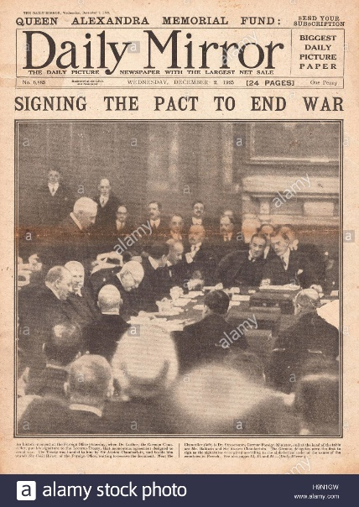
Walk through
13) Explain what the Locarno Treaties, 1925 and The Kellogg-Briand Pact, 1928 did and why the League of Nations was not involved in these negotiations.
Locarno Treaties, 1925 | Kellogg-Briand Pact, 1928
Why wasn’t the League of Nations involved?
Exam question: Source B supports the Locarno Treaties. How do you know?
(4 marks)
Answer
________________________________________________________________________________________________________________________________________________________________________________________________________________________________________________________________________________________________________________________________________________________________________________________________________________________________________________________________________________________________________________
__________________________________________________________________________________________________________________________________________________________________________________________________________________________________________________________________________________________________________________________________________________________________________________________________________________________________________________________________________________________________________________________________________

Slide 20
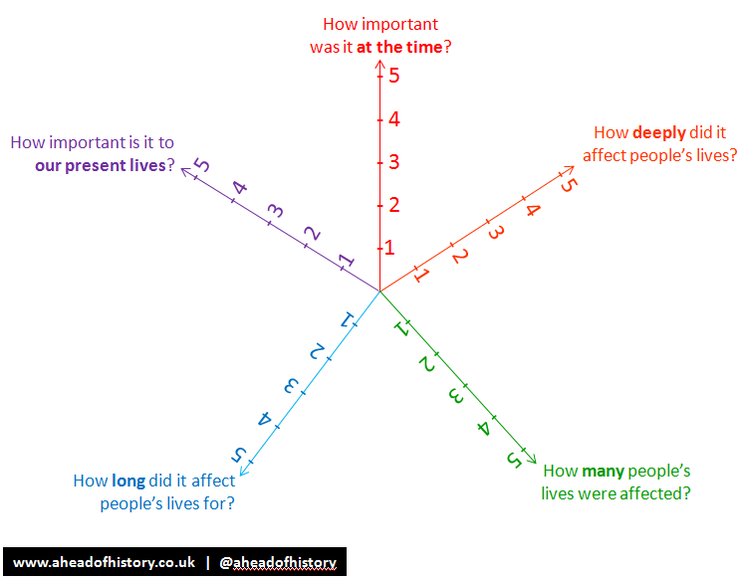
14) Complete the significance radar to show the impact of the Great Depression in Europe. Remember class discussion about how the Depression allowed the rise of extremist politics as people were desperate for a solution.
Overview video
Overview Seneca
12) How did the Great Depression affect the League of Nations?
____________________________________________________________________________________________________________________________________________________________________________________________________________________________________________________________________________________________________________________________________________________________________________________________________________________________________________________________________________________________________________________________________________________________________________________________________________________________________________________________________________________________________________________________________________________________________________________________________________________________________________________________________________________________________________________________________________________________________________________________________________________________________________________________________________________

Slide 21
15) Use the timeline to show the story of the Manchurian Crisis in 1931-32. Include :
Why Japan wanted Manchuria
The Mukden incident
League’s reluctance to act
Eventual League action
Seneca
Walkthrough

Slide 22
16) Use the timeline to show the story of the Abyssinian Crisis in 1936.
Include :
Why Mussolini wanted Abyssinia
How Mussolini invaded Abyssinia
The actions the League took in Abyssinia, including what Britain and France did
Seneca
Walkthrough

Slide 23
Abyssinia
Manchuria
Powers and membership
17) Complete the Rubik’s cube to show the reasons why the League of Nations failed.
Make sure you understand all of the words
Take care, some words may apply to more than one section… but they only go in one place.
Hoare-Leval Pact
Moral condemnation
May 1936
Manchukuo
Japan
18th September 1931
Trade with the USA
Military sanctions
Mussolini
Britain
Italy
Effect of the Depression
Permanent members
Haile Selassie
Oil, steel, coal
France
Economic sanctions
America
February
1933
Collective security
Lord
Lytton
Leaked
Veto
Explosion
Railway
Suez
Canal
Addis
Ababa

Slide 24
18) Complete the table to plan the answer to the following exam question.
“The League of Nations was doomed to fail.” How far do you agree? Explain
your answer.
Agree | Disagree
Conclusion

Slide 27
Seneca
BBC Bitesize
19) Match the definition to the correct keyword.
B
B
C
Keyword |  | Definition
Lebensraum |  | Another name for Communism, a system of government in which everyone is considered equal.
Volksdeutsche |  | German term for ‘living space’
Anschluss |  | Book written by Hitler; the title means ‘my struggle’.
Mein Kampf |  | People of the German race/German speakers
Bolshevism |  | Uniting Germany and Austria
18) Explain how each of Hitler’s aims would lead to war.
Lebensraum
Rearmament
Reunite Volksdeutsche and create a Greater Germany
Destroy Communism

Slide 28
Bitesize
20) Complete the timeline to show the early steps that Hitler took. Make sure you highlight the role of Britain, France and Italy as you go.
B
B
C
13th January The Saar plebiscite
June 1935 Anglo-German Naval Agreement
13th January 1935 The Saar plebiscite
March 1935 Rearmament
1933 Hitler leaves the League of Nations Disarmament Conference
1934 The Dolfuss Affari

Slide 29
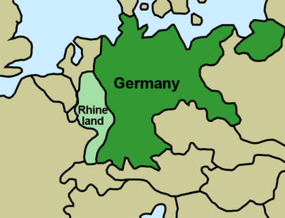
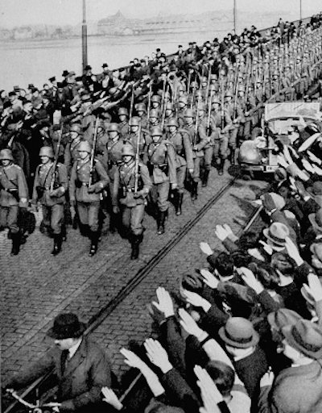
21) Use the pictures to help explain the story of the Rhineland
Bitesize
Newsreal
Why had the Rhineland been demilitarised?
What happened when troops entered the Rhineland?
Could Hitler have been stopped?
How did the gamble pay off for Hitler?
Which countries supported Hitler? Use your classwork and https://www.bbc.co.uk/bitesize/guides/znxdnrd/revision/3 to help you.
Supported Hitler | Against Hitler

Slide 30
22) Create a storyboard to show what happened during the 1938 Anschluss. Keywords to include are: Schuschnigg Seyess-Inquart Mussolini Berchtesaden Plebiscite
B
Bitesize 1
Bitesize 2
B
C

Slide 31
23) Fill in the Venn diagram to show the similarities and difference between the Remilitarisation of the Rhineland in 1936 and Anschluss in 1938.
Rhineland 1936
Anschluss 1938
23) How did countries react to Anschluss? Complete the table to show your ideas.
Austria
Germany
Britain and France
Czechoslovakia

Slide 32
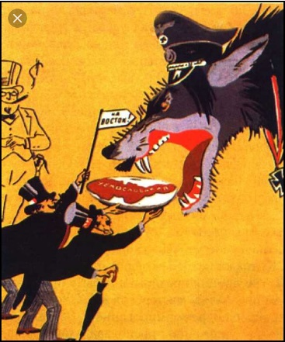
Click through the pages to revise first
24) Study sources A and B. How useful are Sources A and B to a historian studying why Hitler invaded Czechoslovakia
B
B
C
Source A: a Russian cartoon from 1938; the caption reads 'Onwards to the east!' and the 'meat' on the plate is labelled Czechoslovakia
Source B: Adapted from a note from General Ismay, the Secretary of the Committee of Imperial Defence, to the British Cabinet, sent on 20th September 1938:
If Germany swallows up Czechoslovakia it will enhance German military prestige, increase German potential for war, and enable Germany to deploy stronger land forces against France and ourselves than can be done at present.
 | What the source says/ who created it | Why is this useful? Explain what you know that can add detail to these points
 | Content
Source A | The wolf is Germany; the two men in the left hand corner are Britain and France; the see-through man is the USA | e.g. Britain and France offering the ‘meat’ on a plate…
Source B | The source suggests Hitler wants Czechoslovakia because it will: make his army proud and prepare them for way
 | Provenance
Source A
Source B

Slide 33
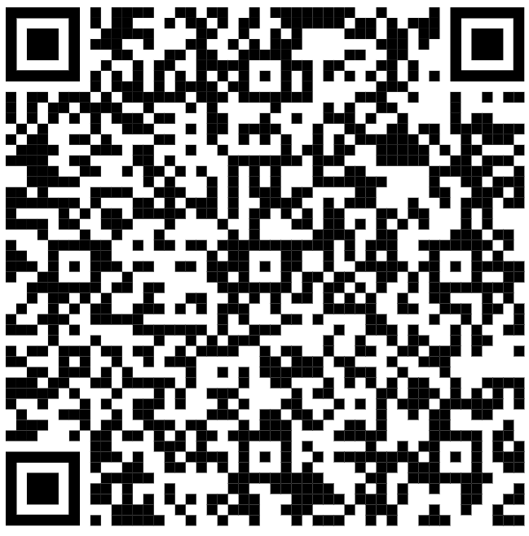
For
Against
Review
25) Arguments for and against appeasement. Complete the diagram with as many points as you can to demonstrate whether appeasement was a good idea or not.
B
B
C
For appeasement | Against appeasement
In your opinion, was appeasement the right policy to use?
People misjudged Hitler. They thought he could be reasoned with. Everything he said throughout the 1920s indicated that he would use violence. They should have known better.
Appeasement

Slide 34
Outline
Fast detail
26) Read the background to the Nazi-Soviet Pact and highlight the information that challenges the Treaty of Versailles and completes Hitler’s aims.
By late 1938 Hitler had taken over both Austria and Czechoslovakia. Poland was Hitler’s next step in his quest for Lebensraum. In the hatred Treaty of Versailles, areas of German land had been given away to form a new state of Poland. Many Germans lost their property or found themselves living outside Germany. When Hitler came to power he vowed to destroy the Treaty of Versailles, to reunite German-speaking people, and to claim Lebensraum in the east. Invading Poland would help him to achieve all of these aims.
Furthermore, Hitler had grown confident. He had seen Britain and France fail to take action against him as he broke the terms of Versailles and felt that, even though they had made agreements to protect Poland, they would do nothing to stop him invading the country. Finally, Poland had no natural borders e.g. mountains, so would be easy to attack. However, Hitler still had a problem… What would the USSR do if he invaded Poland?
Both Germany and the USSR despised Poland and had immediately started questioning it’s existence. Stalin was determined to reclaim this land and Hitler was concerned about what Stalin would do if the German’s invaded. Hitler could not risk Stalin intervening, so he sent his foreign minster, Joachim von Ribbentrop, to male a deal. If the USSR allowed Hitler to invade Poland, the USSR would be given Polish territory. On 23rd August 1939 a non-aggression pact was signed. It was called the Nazi-Soviet Pact.
Hitler could invade Poland without facing a war on two fronts. Britain and France might act but the USSR would stay out of it.
Becoming allies with Hitler meant that Stalin didn’t worry about attack from Germany.
Land in Poland would act as a buffer zone if Hitler decided to invade the USSR.
The USSR had a massive army that was no longer a threat.
Stalin felt he had been ignored by GB and Fr. He knew he couldn’t trust them if Germany invaded the USSR
Britain and France would now face a war with Germany without the USSR as an ally.
Hitler seemed to respect the USSR.
Hitler agreed that Stalin would be given Polish land and he wouldn’t even have to fight
What was in it for Germany? | What was in it for the USSR?

Slide 35
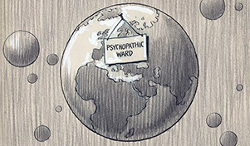
27) Read the final piece of the puzzle and annotate the cartoon to suggest what it might be trying to say about the state of Europe in 1939.
Declaration
Topic test
The invasion of Poland
On 1st September, 1939 the German battleship, the Schleswig-Holstein opened fire on the port of Danzig. Although Poland ran it, 90% of the population was German. At the same time, 62 divisions of the German army and 1300 Luftwaffe planes invaded Poland. The Polish air force was caught on the ground and obliterated.
On 3rd September, 1939 Britain sent an ultimatum to Hitler to withdraw his troops by 11am. When no reply came, Britain declared war on Germany. Poland was overrun by German and Soviet troops within 4 weeks. Hitler was convinced Britain and France would back down. He was wrong and WWII began.
An American cartoon published on 1 September 1939. A psychopath is someone with a personality disorder, which can lead to dangerous and violent behaviour.

Slide 36
28) Go over your work to enable you to complete the exam question planning in good detail. You may also want to use the diagrams on the next couple of pages to help you.
‘The Nazi-Soviet pact was the main reason for the outbreak of the Second World War in 1939.’ How far do you agree with this statement? Explain your answer. (16 +4)

